Slide 1

nmrML: Standing on the shoulders of Giants
Leibniz-Institut für Pflanzenbiochemie
Daniel Schober, IPB Halle
for COSMOS WP 2

Slide 2
Outline
Part I: nmrML
Challenges in metabolomics data storage
Introduction to nmrML
XSD & CV
Inhouse data example
Outlook & Questions
Part II: Ontological errors in existing CVs

Slide 3
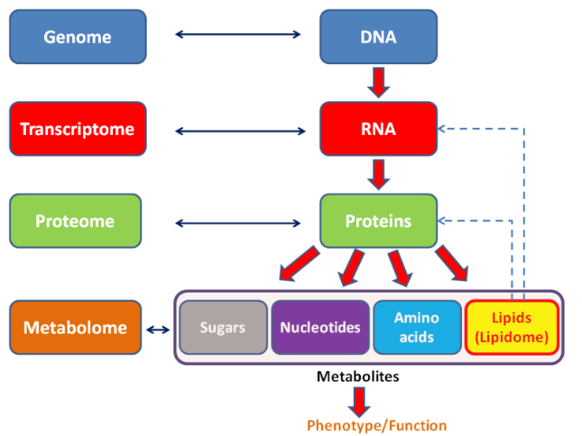
Metabolomics
MS & NMR

Slide 4
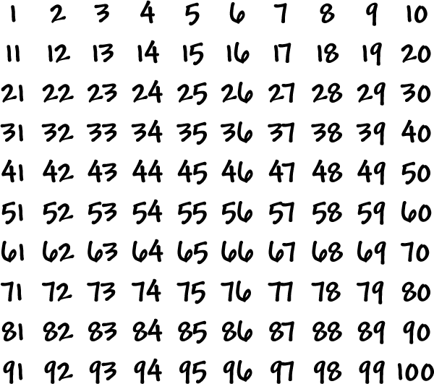

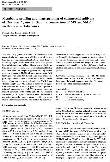
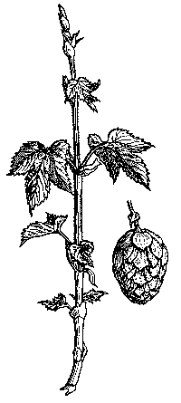

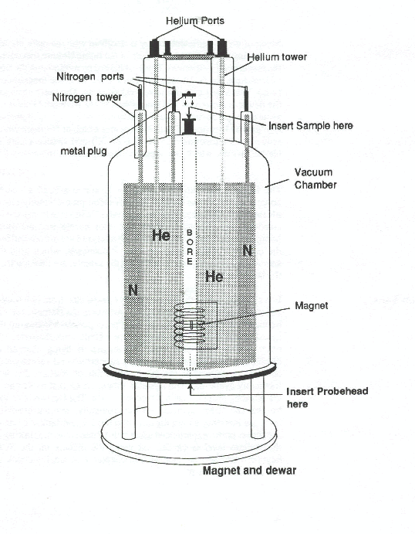
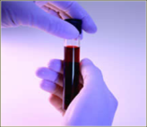
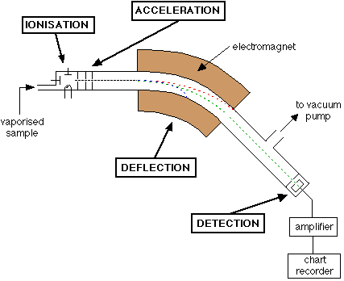


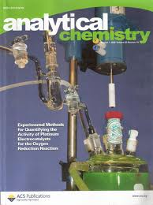
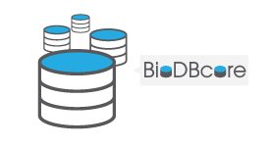


Metabolomics workflow
Wet laboratory
Bioinformatics
Publication
Data storage, analysis
& interpretation
Sample collection
Assay: NMR, MassSpec, …
Findings
Data
Local inhouse management &
long term storage
Standard Needed !
Diverse technologies, parameters & data formats
Vendor formats are incompatible, verbose & hard to interpret
Data silos with restricted access
→ Need for open standard for robust data storage, sharing, retrieval & interpretation

Slide 5
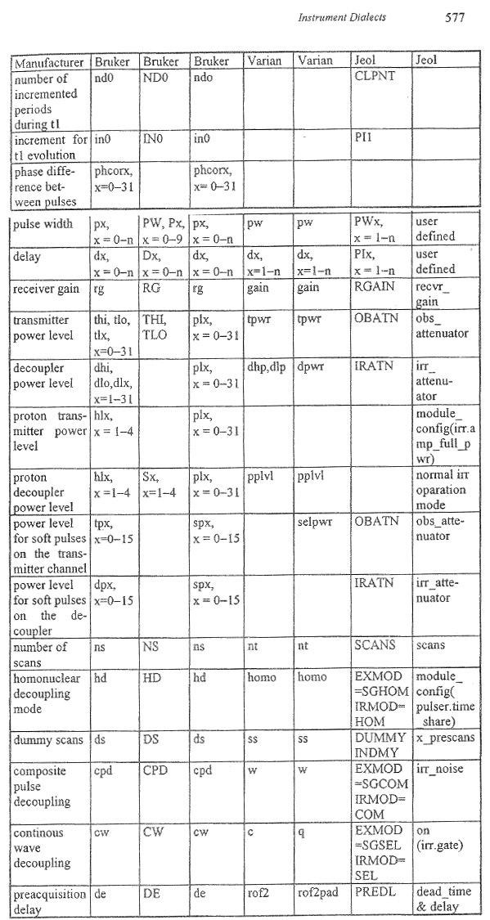
NMR formats
Variety in
parameters & vendor formats
Many synonyms:
relaxation delay, dx, PIx

Slide 6

Synonyms for ‚Irradiation Frequency‘ in NMR
„Nmr frequency“
„electromagnetic excitation“
„nuclei irradiation“
<xs:element maxOccurs="1" minOccurs="1" name="irradiationFrequency" type="ValueWithUnitType"> </xs:element>

Slide 7

nmrML requirements
Vendor-neutral open exchange & storage format
Understood by open tools & public repositories
Simple (!) standard to facilitate data mining & reuse
Human & computer readable
Using CV for synonym-convergence & homonym- resolution
Inspired by mzML for Mass Spectrometry

Slide 8
nmrML Use cases
Facilitate access to structured metabolomics data
Increase secondary data usage
Increase data persistence
Increase data quality by content-validation
Allow intelligent data mining
More detailed search & comprehensive retrieval
Homonym resolution, synonym coverage, generalisation, …

Slide 9


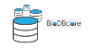

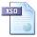





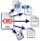


nmrML usage & implementation
coordinates
Open NMR Format
nmrML.xsd
Data Repositories
EU 7th FP, WP 2
Persistent storage
nmrML combines XML elements
with controlled terms
in one XML file
Global
nmrCV.owl
MetaboLights
Local
Data Processing
Format Conversion
Semantic Validators
Parsers for vendor formats
JCampDX
Open NMR Tools
MetaboQuant

Slide 10
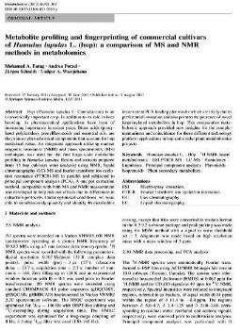
Example: annotation of ‚material & methods‘
XML-based annotation with nmrML
NMR analysis
All spectra were recorded on a
<Varian NMR Instrument> Varian VNMRS 600 NMR Spectrometer </Varian NMR Instrument>
operating at a proton NMR frequency of
<Irradiation frequency>599.83 <Megahertz>MHz</Megahertz> </Irradiation frequency>
using a <cryoprobe>5 mm inverse detection cryoprobe</cryoprobe>.
<acquisition nucleus>1H</acquisition nucleus> NMR spectra were recorded […].
object
instrument
NMR instrument
Varian NMR instrument
Varian VNMRS 600 NMR spectrometer
part of NMR Instrument
NMR probe
cryoprobe
5 mm inverse detection cryoprobe
parameter
acquisition parameter
acquisition nucleus
1H
Irradiatation frequency
unit
frequency unit
Megahertz
nmrCV
reference

Slide 11
XSD validates XML
XML Schema (simplified)
<xs:complexType name=“acquisitionParameterSet"> <xs:element name="acquisitionNucleus" type="CVTermType"/>
<xs:element maxOccurs="1“ name="irradiationFrequency" type="ValueWithUnitType">
</xs:element> […] </xs:complexType>
XML data file (example)
<acquisitionParameterSet> <acquisitionNucleus
name="1H“
cvRef=“nmrCV“ accession="NMR:1400151" />
<irradiationFrequency value="599.8311617" unitName=“Hertz" unitCvRef="UO" unitAccession="UO:0000106"/> </acquisitionParameterSet>
→ XSD ensures cardinalities & proper nesting

Slide 12

nmr ML data landscape
WORKFLOW STANDARD (XSD+CV) MINIMAL INFORMATION
ISA-Tab
(Protocols &
Assays)
Sample Preparation
-Exp Factors
MI Sample Prep for metabolomics,
Mammals→Griffin, 2007
Microbiol→Van der Werf, 2007
Raw data (FID)
Pre-processing
-FFT, LB, phasing
nmrML core
MI NMR spectroscopy,
Rubtsov, 2007
Raw spectrum
Post-processing
-baseline Correction
-Noise reduction
-alignment
nmrML ext
MI Data Ananysis in Metabolomics,
Goodacre, 2007
nmrCV
Cleaned spectrum
MI Chemical Analysis,
Sumner, 2007
Binning / Deconvolution
Peaks List / Patterns
Metabolite Identification
Quantification
nmrIdentML?
nmrQuantML?
Chemical Compounds
Quantifications
MI CIMR Core Information
for Metabolomics Reporting
nmrTab?

Slide 13
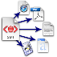




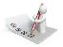



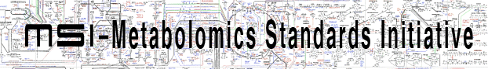

Onion model of validation layers
XML Syntax
Structural validity of nmrML XML instances
Semantic validity of CV term usage
Minimum Information Standard compliance
e.g. CIMR Core Information for Metabolomics Reporting
Journal Policy compliance

Slide 14
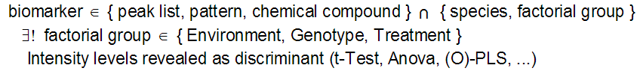
CQ-driven coverage determination
Competency Questions for nmrML
Get all spectra on 500Mz Bruker machine that do 1D H+ Spectra
Get spectra generated via Bruker CryoProbe and D2O solvent
Get nmr Spectra that have been FT transformed and were smoothed via Gaussian smoothing
What spectra used flow high resolution probe in the instrument?
Get 1D spectra with doublets in ppm range x to y
CQ for nmrCV and IdentML CV
Get spectra that identified a high concentration in Phenylethylamines
CQ that need ISA annotation or an nmrTab
Show spectra for Human Urine samples that investigate doping chemicals
Show me nmr spectra for changes in metabolites involved in Citrate Circle after Fat consumption in Human
More Formal DL formalisation of a CQ
E.g. look at http://omiabis-dev.googlecode.com/svn/branches/CompetencyTest.owl
nmrML core
nmrML ext
nmrIdentML?
nmrQuantML?
nmrTab?
ISA Tab

Slide 15
nmrML example instance
The Full Monty
<nmrML xmlns:xsi="http://www.w3.org/2001/XMLSchema-instance" xsi:schemaLocation="http://nmrml.org/schema ../../../xml-schemata/nmrML.xsd" xmlns="http://nmrml.org/schema" version="1.0.0">
<cvList count="2"> <cv fullName="nmrML Controlled Vocabulary" version="0.0.1" id="NMRCV" URI="http://www.nmrml.org/nmrml-cv.0.0.1.owl"/> <cv fullName="Unit Ontology" version="3.2.0" id="UO" URI="http://unit-ontology.googlecode.com/svn/trunk/uo.owl/"/> </cvList>
<contactList> <contact id="ID004" fullname="Lutger A. Wessjohann" email="Ludger.Wessjohann [a] ipb-halle.de"/> <contact id="ID044" fullname="Mohamed A. Farag" email="mfarag73 [a] yahoo.com"/> </contactList> <sourceFileList count="2"> <sourceFile sha1="fd99c095046e2356c7d31154d45353fa79cbc844"
location=file:///Users/mike/Projects/nmrML/nmrML/examples/IPB_HopExample/FIDs/FAM013_AHTM.PROTON_04.fid/procpar
id="SOURCE_FILE_0" name="procpar"> <cvTerm cvRef="NMRCV" accession="NMR:1400297" name="Varian VNMR Format"/> <cvTerm cvRef="NMRCV" accession="NMR:1002006" name="acquisition parameter file"/> </sourceFile> <sourceFile sha1="e4ffeb41da28b1e9017e72819252ec6d78f8179f“
location=file:///Users/mike/Projects/nmrML/nmrML/examples/IPB_HopExample/FIDs/FAM013_AHTM.PROTON_04.fid/fid
id="SOURCE_FILE_1" name="fid"> <cvTerm cvRef="NMRCV" accession="NMR:1400297" name="Varian VNMR Format"/> <cvTerm cvRef="NMRCV" accession="NMR:1400119" name="FID file"/> </sourceFile> </sourceFileList> <softwareList count="1"> <software cvRef="NMRCV" accession="NMR:1000277" name="VnmrJ software" version="2.2C" id="SOFTWARE_1"/> </softwareList>

Slide 16
<instrumentConfigurationList count="4"> <instrumentConfiguration id="INST_CONFIG_1"> <cvTerm cvRef="NMRCV" accession="NMR:1400234" name="Varian NMR instrument"/> <cvTerm cvRef="NMRCV" accession="NMR:1000235" name="Varian probe"/> <cvTerm cvRef="NMRCV" accession="NMR:1400234" name="Varian NMR instrument"/> <cvTerm cvRef="NMRCV" accession="NMR:1000236" name="5mm HCN probe"/> </instrumentConfiguration> </instrumentConfigurationList>
<acquisition> <acquisition1D> <acquisitionParameterSet numberOfScans="160" numberOfSteadyStateScans="0"> <sampleAcquisitionTemperature unitName="kelvin" unitCvRef="UO" value="299.15" unitAccession="UO:0000012"/> <spinningRate unitName="hertz" unitCvRef="UO" value="0" unitAccession="UO:0000106"/> <relaxationDelay unitName="second" unitCvRef="UO" value="22.2737024" unitAccession="UO:0000010"/> <pulseSequence/> <DirectDimensionParameterSet numberOfDataPoints="65536" decoupled="false"> <acquisitionNucleus cvRef="NMRCV" accession="NMR:1400151" name="1H"/> <gammaB1PulseFieldStrength unitName="hertz" unitCvRef="UO" value="34482.7586207" unitAccession="UO:0000106"/> <irradiationFrequency unitName="hertz" unitCvRef="UO" value="599.8311617" unitAccession="UO:0000106"/> </DirectDimensionParameterSet> </acquisitionParameterSet> <fidData byteFormat="Complex128" encodedLength="324160" compressed="true">eJwMl4dfzl8Ux7U3lYZKy0qiomQ […]</fidData> </acquisition1D> </acquisition> </nmrML>

Slide 17
Parser Workflows & Format Conversions
Proprietary Vendor Formats
JAVA parser Bruker
D. Jacobs, Bordeaux
Python parser Varian
M. Wilson, Alberta
ISA-Tab
Other Parsers
nmrML to MAF
nmrML to JCamp-dx
Open nmrML
Metabolomics DBs
Metabolights
HMDB, …
Visualisations
e.g. nmr spectra viewer
nmrIO R package
S. Neumann, Halle
Statistical processing
R, rNMR, Batman

Slide 18
Current status & outlook
First release nmrMLstandard (XSD+CV) Feb 2014
www.nmrML.org
Minoir feedback & community involvement so far…
Specification document, XSD, CV & example XML files
Good coverage on raw data, less on multidimensional & processed NMR data
CV-coverage limited to few use cases
Vendor to nmrML Parsers available
Validation rule set enforced on obo converted owl nmrCV
via hacked OpenMS validator
validation of raw data only, MI enforcement at later stage
Extend nmrML core, start nmrIdentML, nmrQuantML & nmrTab
Interaction with vendors

Slide 19
Questions
CopyCating PSI XML-CV architecture & re-using PSI validators is feasable to support COSMOS MSI standards
XSD & CV modularisation ?
One large vs. multiple small ones
CV-reuse from Bioportal
How to solicit feedback & community involvement ?
Semantic Validator for owl ?
SWRL based ?
Exploit Subsumption reasoning ?

Slide 20
Part 2: Ontological errors in existing CVs

Slide 21
Why analyzing predecessor CVs
Avoid errors in COSMOS nmrCV
Don’t copy ad-hoc design-issues from PSI model
Improve quality of existing CVs
Provide feedback if that‘s welcome
Ease their re-use for COSMOS
Simplify validation rules
no need to compensate errors via complicated rules

Slide 22
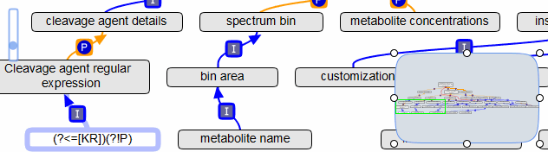
Example: old nmrCV
Is a ‘bin area’ a ‘spectrum bin’ ?
→ Taxonomic error, use part_of ?
Is a ‘metabolite name’ a ‘spectrum bin’ ?
→ Use-mention error, use is_proxy_for ?

Slide 23
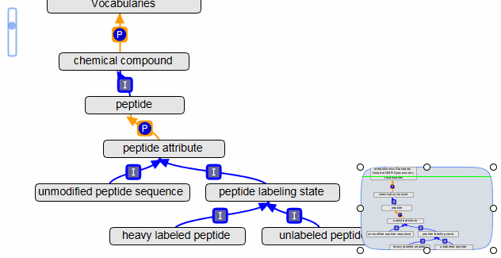
Example: PSI msCV
Is a ‘peptide’ part_of a ‘vocabulary’ ?
→ Use-mention error, use TLO
Transitivity: ‘heavy labeled peptide’ part_of ‘peptide’ , should be Is_a ?

Slide 24
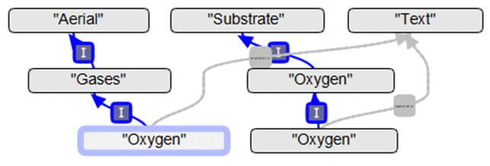
Example: XeoCV
An Oxygen is a Gases ?
→ Plural violation, naming convention violation
Definition: "Defines the concentration of O2 in the air"
→ Not in sync with label and taxonomy
(Another) Oxygen is a Substrate ?
→ Confusion with role , use
Oxygen has_role Substrate
Multiple occurrences of classes with same name
→ Redundancy errors

Slide 25
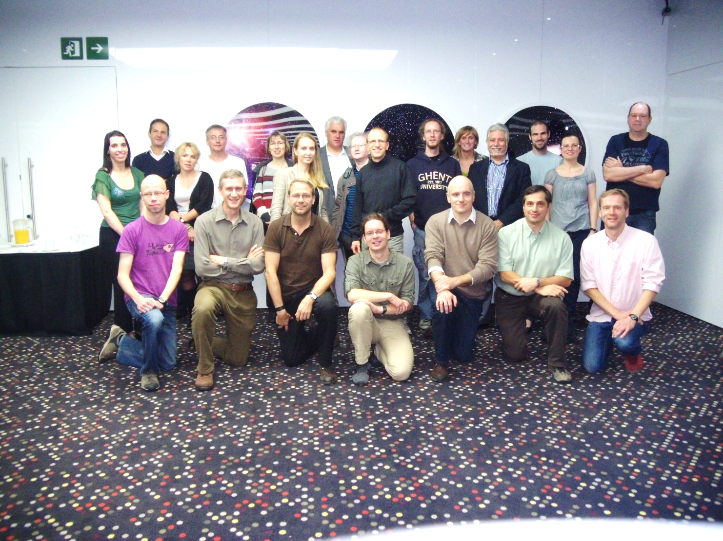

Acknowledgements
WP 2 nmrML group
Reza Salek, Mike Wilson, Steffen Neumann, Daniel Jacob, Christian Ludwig, Ulrich Günter, Catherine Deborde, Antonio Rosato, Tim Ebbels, Kenneth Haug, Annick Moing, Luis de Figueiredo, Philippe Rocca Serra, Jie Hao
Andrea Porzel, Lutger Wessjohann, Filipe Furtado
Mike Wilson from D. Wishart Lab, University of Alberta
EU FP7 project COSMOS grant EC312941 www.cosmos-fp7.eu

